Slide 1

Multiway Merge Algorithm and LZW compression-decompression
The Multiway Merge Algorithm is a powerful and efficient data sorting technique implemented in Java. It combines multiple sorted lists into a single sorted list, optimizing performance and handling large datasets.

Slide 2

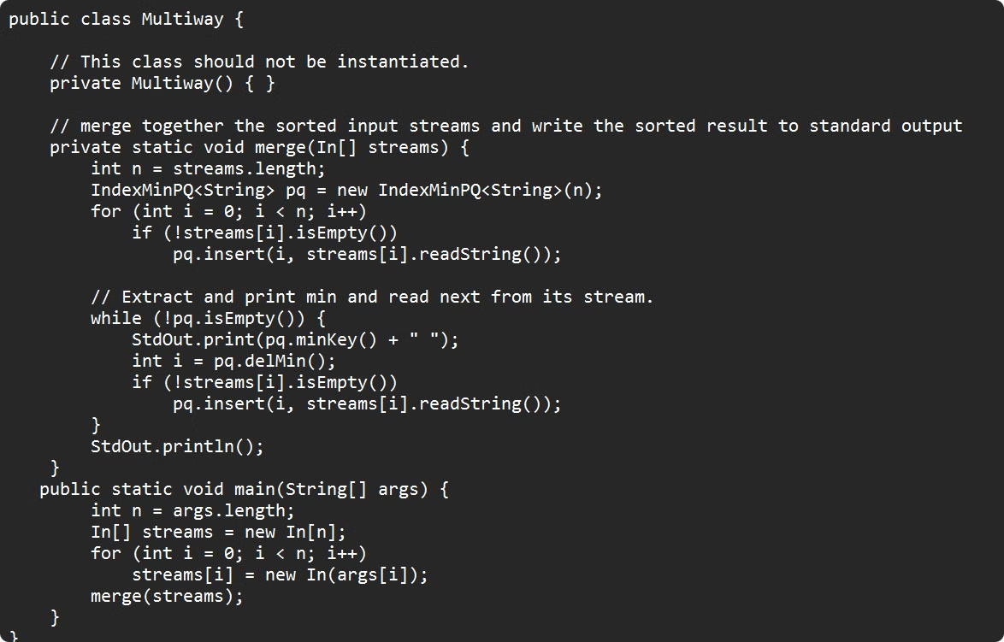
Multiway Merge Algorithm
The Multiway Merge Algorithm takes in multiple sorted data streams and merges them into a single sorted output, preserving the order and efficiency of the sorting process.

Slide 3
Real-Life Applications of Multiway Merge
Database Indexing
Multimedia Streaming
Scientific Computing
Multiway merge helps index and search large databases by efficiently organizing and merging data.
It ensures smooth playback of audio and video content by merging and prioritizing data streams.
Researchers use multiway merge to combine and analyze large datasets from experiments and simulations.

Slide 4

Benefits of Multiway Merge Algorithm
1
Improved Efficiency
2
Enhanced Scalability
Multiway merge significantly reduces the number of comparisons and merging steps required.
It can handle large datasets by dividing and conquering the sorting process.
3
Reduced Memory Usage
4
Faster Performance
The algorithm's optimized design leads to faster sorting times, especially for huge datasets.
Multiway merge minimizes the memory footprint compared to traditional sorting algorithms.

Slide 5
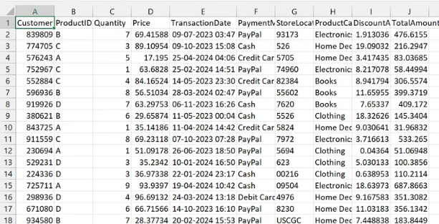
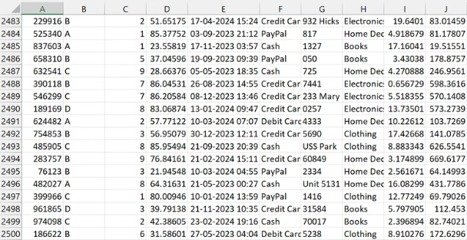
Data set: Financial Transactions
The data set is in a CSV format that involves financial transactions . Our motive is to take 2 (or more) data sets of financial transactions and merge them into one , the output is returned as a CSV file having the data merged in a sorted manner based on the parameter we select.
Dataset 1 involves 2500 elements

Slide 6
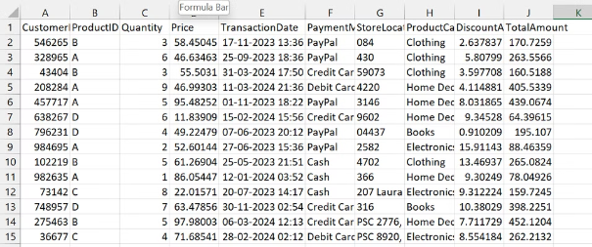
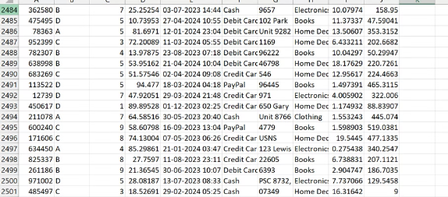
Data set 2 involves 2501 elements:

Slide 7
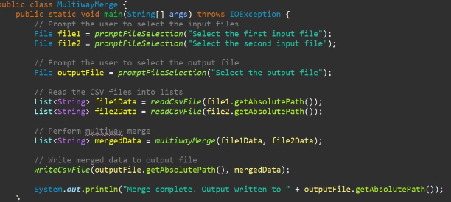
This part of the code calls a method promptFileSelection() that prompts the user to choose a file through a file dialog or console input.
It asks the user to select two files: the first input file (file1) and the second input file (file2). These files will contain the data that will be read and merged.
The method readCsvFile() is called for both file1 and file2. It presumably reads the content of each CSV file and stores it into a list of strings (List<String>). Each string in the list might represent a row or a line from the CSV file.
The getAbsolutePath() method is called to get the full path of the files, which is passed as an argument to readCsvFile().
After merging the data, the method writeCsvFile() is called to write the merged data to the specified output file.
The merged data (mergedData) is written to the file whose path is provided by outputFile.getAbsolutePath(). This output file will contain the result of the merge operation.

Slide 8
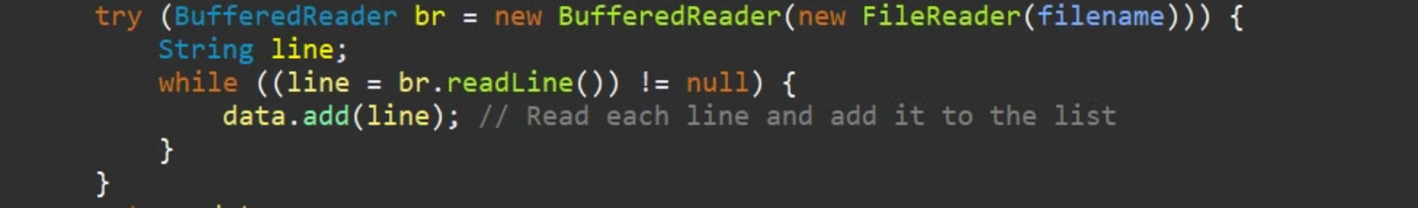
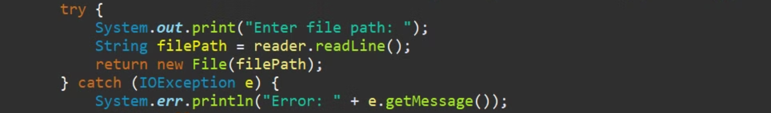
BufferedReader reader = new BufferedReader(new InputStreamReader(System.in));
This line creates a BufferedReader object to read input from the console (System.in). It is wrapped inside an InputStreamReader, which converts the byte stream from System.in into a character stream, allowing us to read text input from the user.
BufferedReader br = new BufferedReader(new FileReader(filename)):
FileReader(filename): This creates a FileReader object to read the file specified by filename. FileReader reads the raw bytes from the file and converts them into characters.
BufferedReader(br): The BufferedReader wraps the FileReader to make reading the file more efficient. It allows reading the file line by line, which is typically faster than reading character by character, especially for large files.

Slide 9
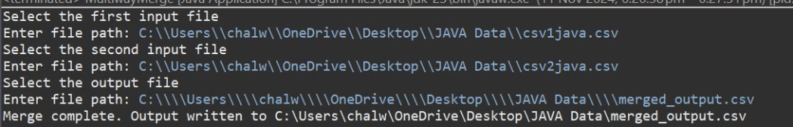
The console looks like this!

Slide 10
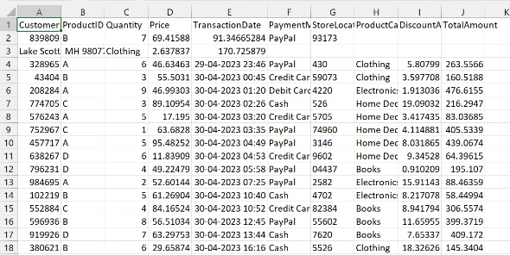
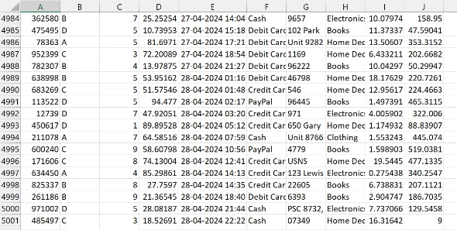
The CSV generated consists of both the merged files , in a sorted order . Here the data is sorted on the basis of date of transaction. Consists of 5001 elements

Slide 11
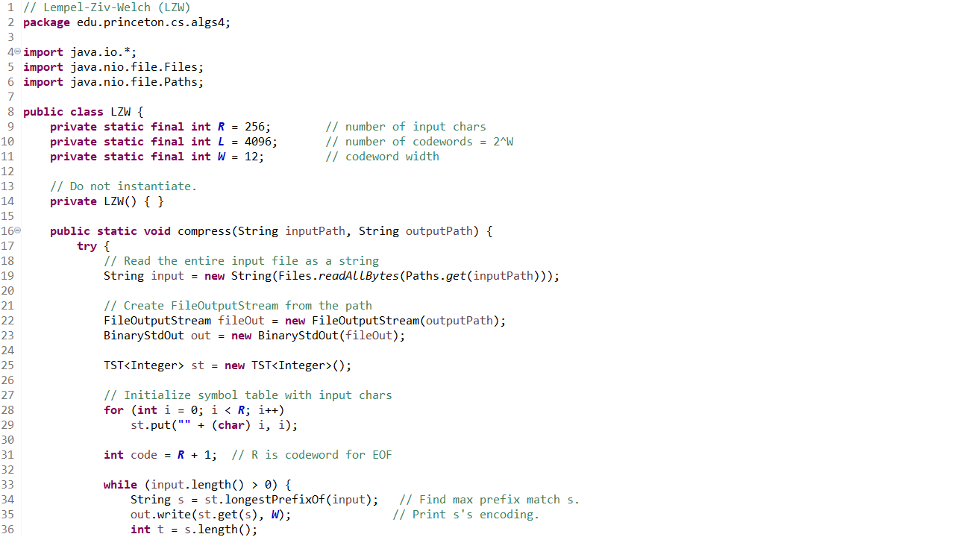
Lempel-Ziv-Welch (LZW) Compression Algorithm Implementation
LZW (Lempel–Ziv–Welch) is a lossless data compression algorithm that replaces repeated sequences of data with shorter codes to reduce file size without losing any original data. It was developed by Abraham Lempel, Jacob Ziv, and later improved by Terry Welch in 1984.

Slide 12
Real-Life Applications of LZW
File Compression Utilities
Digital Fax Transmission
Embedded Systems
Early file compression utilities, such as Unix compress and some versions of ZIP, used LZW. Although newer algorithms have become more common, LZW played a key role in early personal computing by making file storage and transfer more efficient.
Early fax machines used LZW compression to reduce the data size of transmitted pages, helping to speed up transmission over phone lines by minimizing the amount of data.
In embedded systems where memory and storage are limited, LZW compression can reduce the size of data stored or transmitted, particularly in devices that need efficient data storage but have limited processing power, such as medical devices or small electronics.

Slide 13

Benefits of LZW
1
Lossless Compression
2
Efficiency for Repetitive Data
LZW is a lossless algorithm, meaning it compresses data without losing any original information.
LZW works especially well on data with repeated patterns, such as text files
3
Real-Time Compression
4
Simple Implementation
LZW has a relatively simple algorithm compared to some more modern methods, making it easier to implement in software and hardware. This simplicity is advantageous in systems with limited processing power or memory.
This makes it suitable for applications requiring real-time compression, such as streaming data or fax transmission.

Slide 14
Constants Declaration: The LZW class defines three constants:
R (256): Represents the number of input characters (covering the standard ASCII set).
L (4096): The maximum number of codewords, set to 2122^{12}212, which is the dictionary size limit.
W (12): Codeword width in bits, which means each codeword is 12 bits long.
Constructor Restriction: A private constructor is defined to prevent instantiation of the LZW class, as this class only provides static methods.
compress Method: This method takes two parameters:
inputPath: Path of the file to be compressed.
outputPath: Path to save the compressed output.
The method reads the entire input file into a String, preparing it for compression by building a dictionary of codewords that represent repeating patterns in the input.

Slide 15
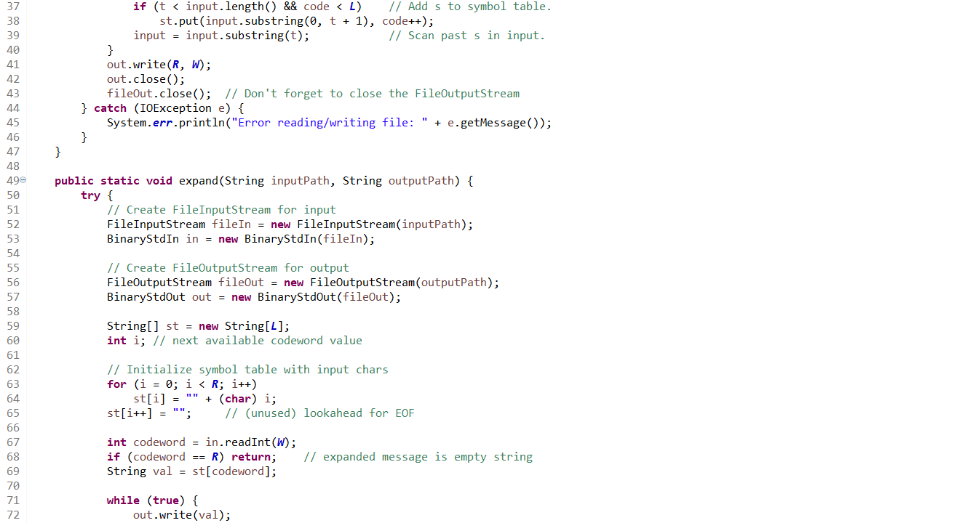
Compress
Symbol Table Update:
If a new code can be added (i.e., code < L), it adds the longest prefix of the input string to the symbol table.
It then updates the input string by removing the matched prefix, moving to the next part of the string.
Writing EOF:
Once compression is complete, it writes an end-of-file marker (EOF) code to the output stream.
Close Streams: Ensures that both the BinaryStdOut and FileOutputStream are closed.
Exception Handling: Catches and handles any IOException that occurs during file operations, printing an error message.
DeCompress
The expand method is responsible for decompressing the compressed file back to its original content.
File Setup:
Initializes a FileInputStream and BinaryStdIn to read the compressed file.
Initializes a FileOutputStream and BinaryStdOut to write the decompressed output.
Symbol Table Initialization:
Creates an array st with size L to store the symbol table for decompression.
Fills st with the ASCII characters (0 to 255) and sets a lookahead entry for the EOF.
Read and Expand:
Reads the first codeword and sets it as the initial val.
Enters a loop that writes val to the output and reads the next codeword.
Handles special cases to manage dictionary updates, ensuring the correct sequence is reconstructed.
This code represents the main operations for compressing and decompressing a file using the LZW algorithm, covering both the compress and expand phases. The methods dynamically manage a dictionary of codewords to handle repeated patterns in the input, reducing file size during compression and reconstructing the original data during decompression.

Slide 16
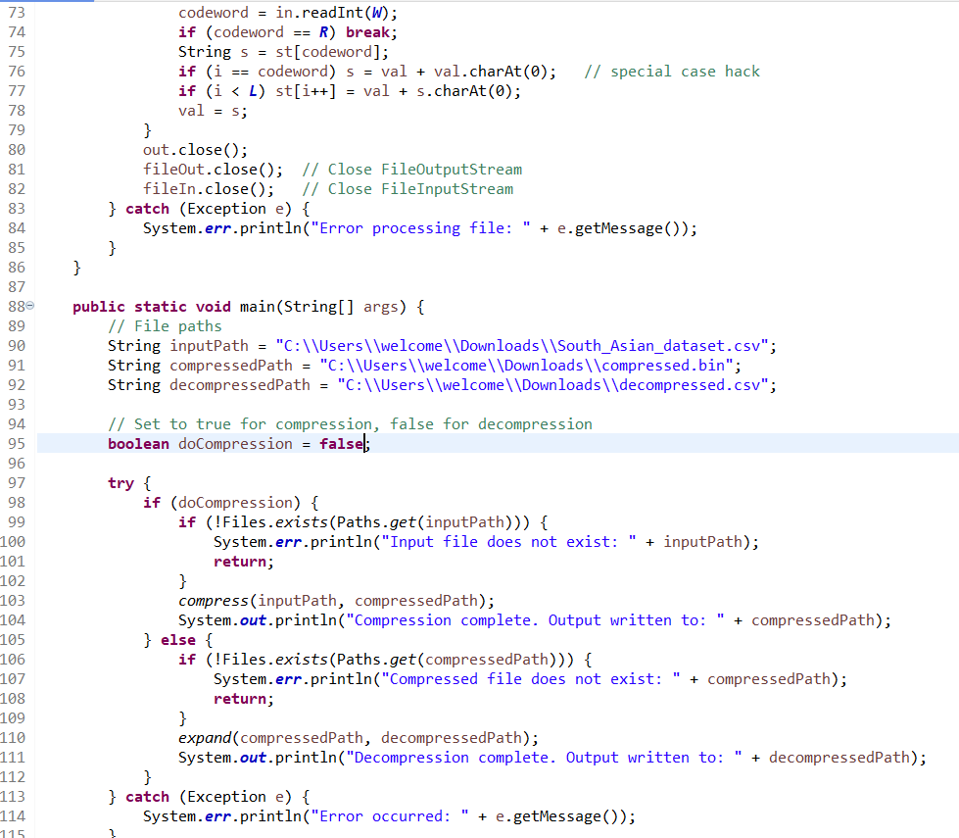
Compression/Decompression Decision: The program checks if doCompression is set to true to perform compression, otherwise it defaults to decompression.
File Existence Check: It verifies the existence of input files (either the original file for compression or the compressed file for decompression) before proceeding.
Decompression Logic: In decompression, the code reads codewords from the compressed file and reconstructs the original data, using an array st as a symbol table for decompression and handling special cases.
File Paths: The program reads and writes to specified file paths for input and output during compression (compressed.bin) and decompression (decompressed.csv).

Slide 17
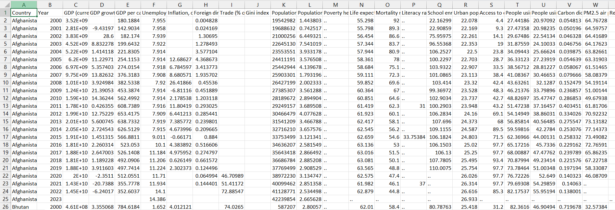
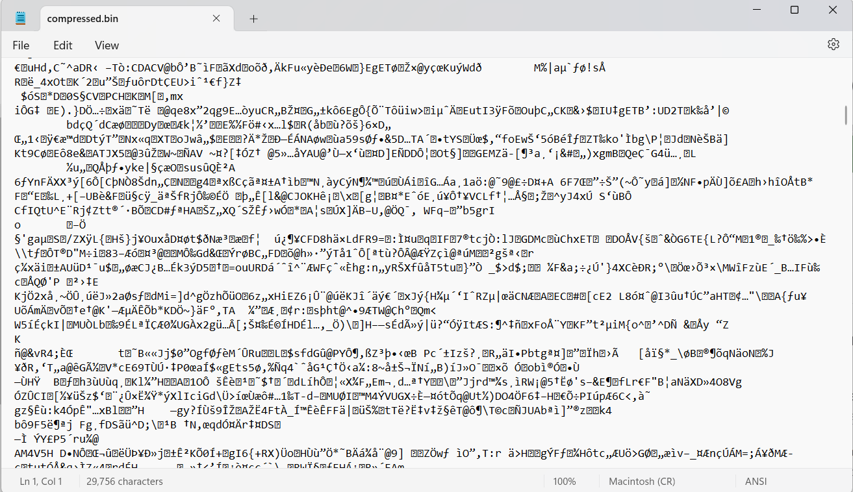
As you can see the data has converted from excel to binary

Slide 18
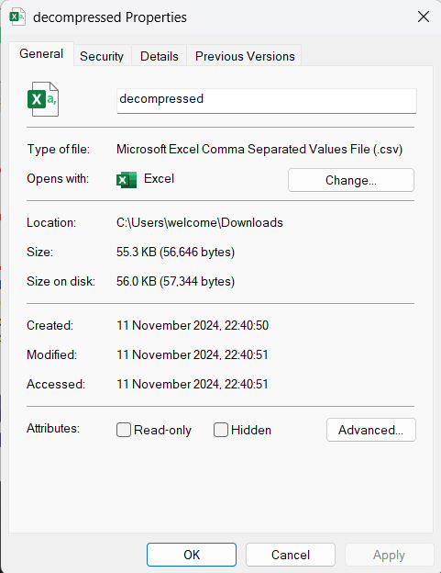
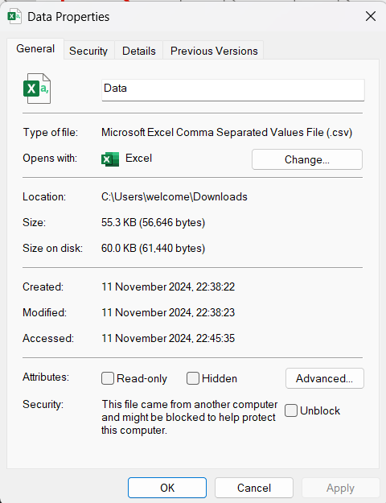
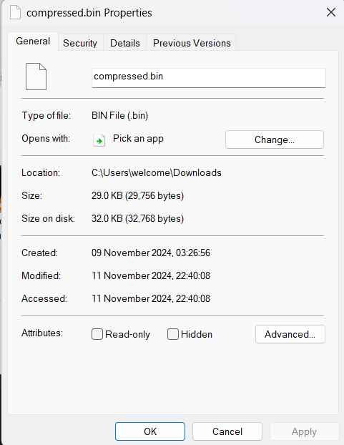
30 KB data has been compressed

